Slide 1
A new restaurant in Copenhagen
In which region would a new restaurant most likely survive?

Slide 2
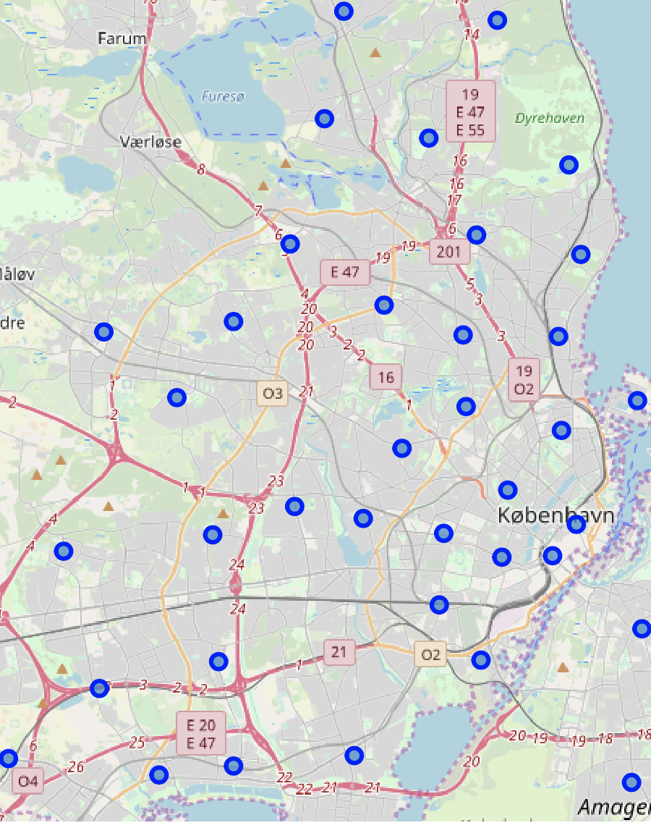
The region centers on map. How to find the best ones to open a new restaurant?
Pre-process Data
Determine Cluster number
Build Clustering Model
Refine Model
Calculate Competition Level
Calculate Determine Feature
Analyze Result

Slide 3
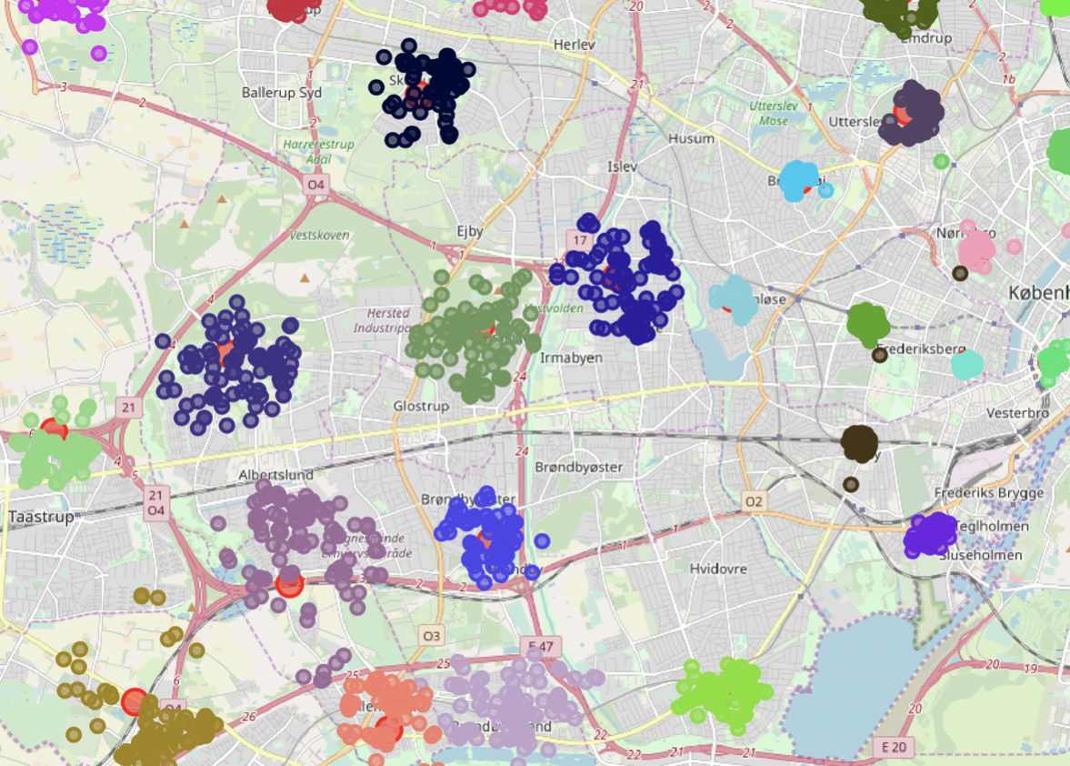
Venues Distribution - limit 100 - Radius 1000m
Remote regions are more spread out, some region even overlapped to each other, while region close to city center are more centralized as the venues locate closer to each other .
Need refine the data quality by increasing data point limit and decreasing the data point radius.

Slide 4
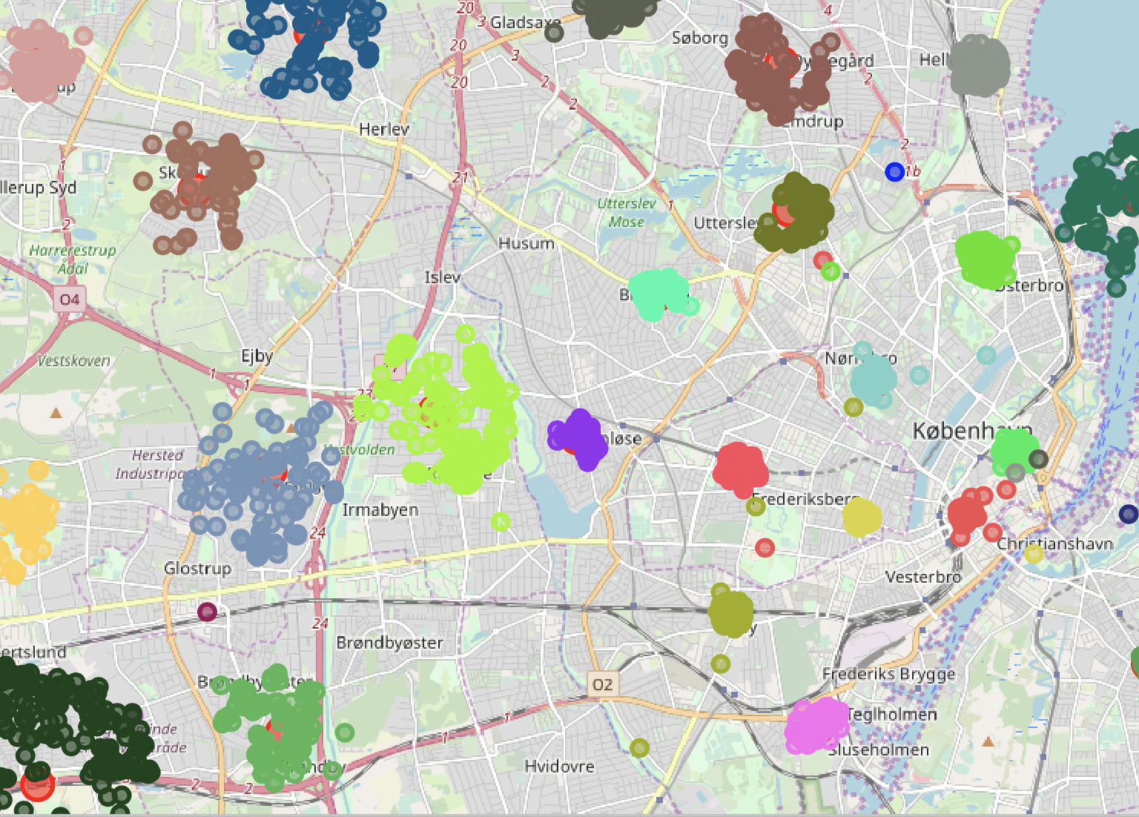
Venues Distribution - limit 200 - Radius 500m
Compared to dataset with limit 100 and radius 1000m, this dataset distribution looks more centralized and less overlapped.
Can be used for further clustering analysis

Slide 5
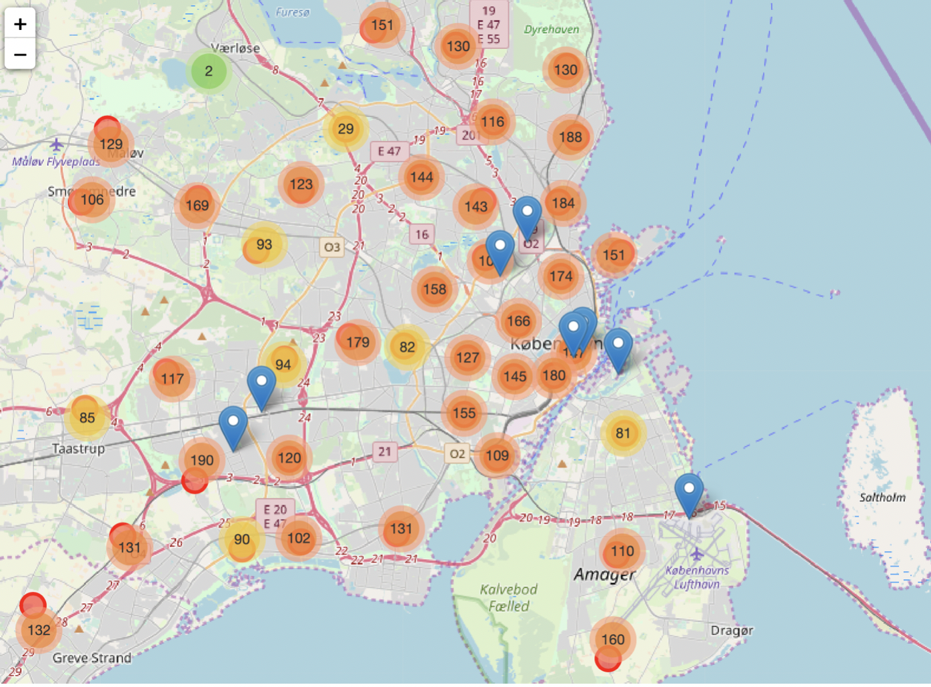
An intuitive presentation of venue numbers in each region.

Slide 6
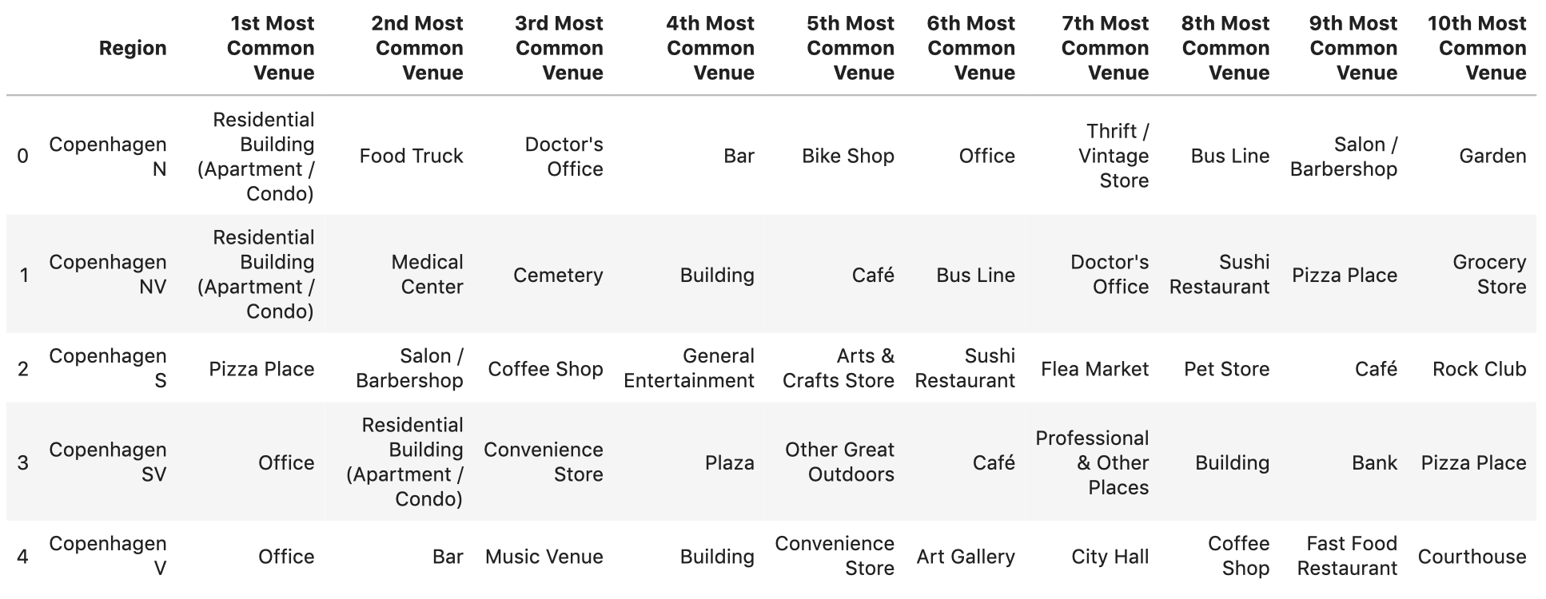
Top venue categories in each region

Slide 7
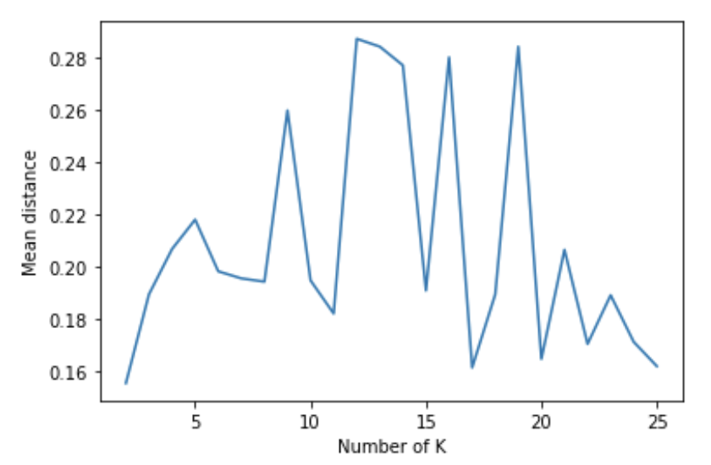
mean distance with different K value
The mean distance has the smallest value when the K value is 2, selected from a range between 2 and 25 .
Making 2 clusters for the 51 regions would lead to a better clustering result

Slide 8
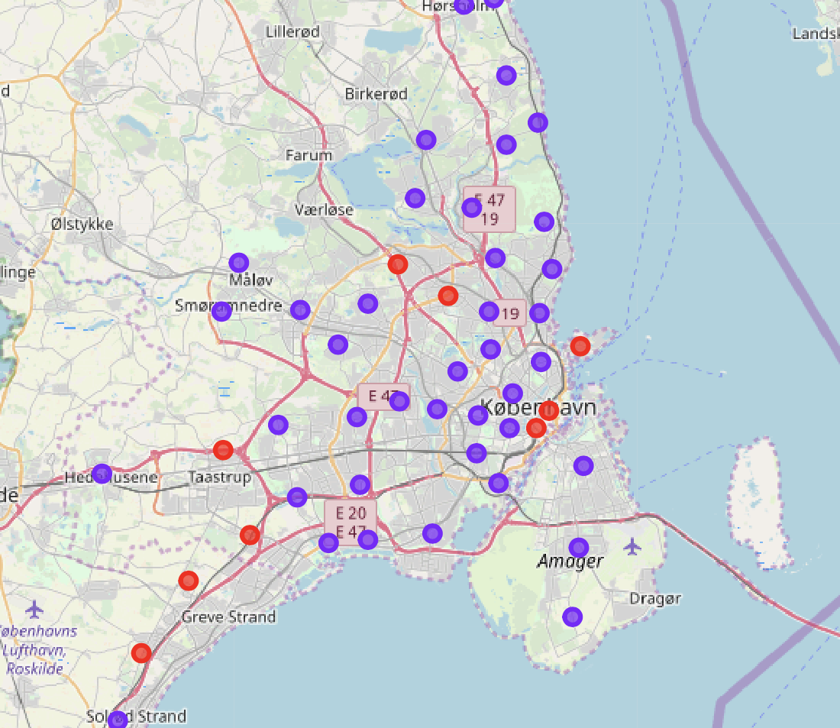
K-means clustering with 2 clusters for 51 regions

Slide 9
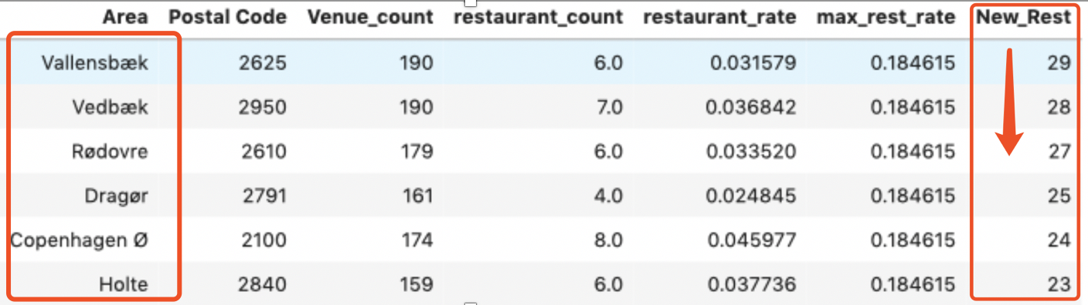
Top 5 regions best for opening a new restaurant : Vallensbæk, Vedbæk, Rødovre, Dragør and Copenhagen Ø.
restaurant_rate = restaurant_count/ Venue_count
max_rest_rate = max(restaurant_rate)
New_Rest = Venue_count * max_rest_rate - restaurant_count

Slide 10
Resources and Tools
Wikipedia: Post codes
Google map geocoding API: Coordinate info
FourSquare API: Venues information
Folium: map creation
SKlearn: machine learning python package
Pandas: Data frame handle package

